Slide 1

iNeuron.ai
Data Visualization FIFA 19
Wireframe Document
Prepared BY
Abhinav Singh

Slide 2
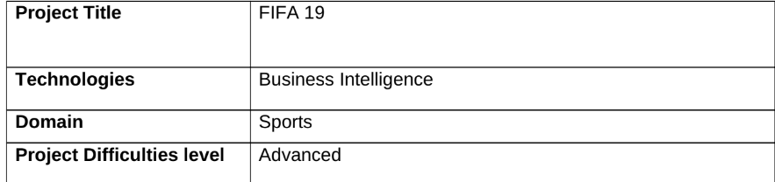
PROJECT DETAIL
OBJECTIVE
Find key metrics and factors and show the meaningful relationships between attributes.
PROBLEM STATEMENT
With Fifa being in the blood as many people of the world. You are tasked to tell the story of
unsung analysts who put great efforts to provide accurate data to answer every question of fans.
Football Game Analytics

Slide 3
ARCHITECTURE
Raw Data Collection
Importing Libraries in Jupyter Notebook
Raw Data Collection
Load Dataset
DEPLOYMENT
Low-Level Design Document High-Level Design Document Architecture Document
Wireframe Document Detailed Project Report
Missing Value Imputations
Data Pre-Processing
Handling Outliers
Load Dataset
Insights
Power BI Desktop
Exploratory Data Analysis (EDA)
Data Cleaning
DATASET INFORMATION
Data includes lastest edition FIFA 2019 players attributes like Age, Nationality,
Overall, Potential, Club, Value, Wage, Preferred Foot, International Reputation, Weak
Foot, Skill Moves, Work Rate, Position, Jersey Number, Joined, Loaned From, Contract
Valid Until, Height, Weight, LS, ST, RS, LW, LF, CF, RF, RW, LAM, CAM, RAM, LM,
LCM, CM, RCM, RM, LWB, LDM, CDM, RDM, RWB, LB, LCB, CB, RCB, RB, Crossing,
Finishing, Heading, Accuracy, ShortPassing, Volleys, Dribbling, Curve, FKAccuracy,
LongPassing, BallControl, Acceleration, SprintSpeed, Agility, Reactions, Balance,
ShotPower, Jumping, Stamina, Strength, LongShots, Aggression, Interceptions,
Positioning, Vision, Penalties, Composure, Marking, StandingTackle, SlidingTackle,
GKDiving, GKHandling, GKKicking, GKPositioning, GKReflexes, and Release Clause.
grid_3x3sort

Slide 4
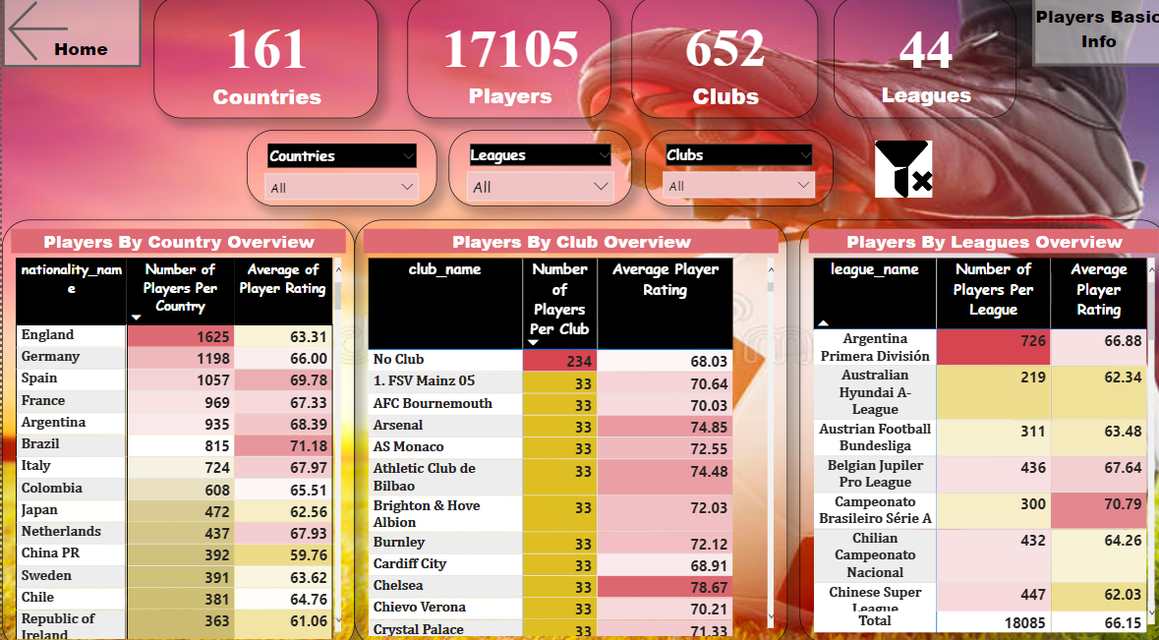
Total 17105 number of Players from 161 different countries are taken for visualization.
These 17105 players are associated with 652 Clubs across the globe and are further playing under different 44 leagues.
There are 234 players who are not registered with any Clubs.
The league Argentina Primera División has highest number of players Registered that is 726 with an average rating of 66.88%

Slide 5
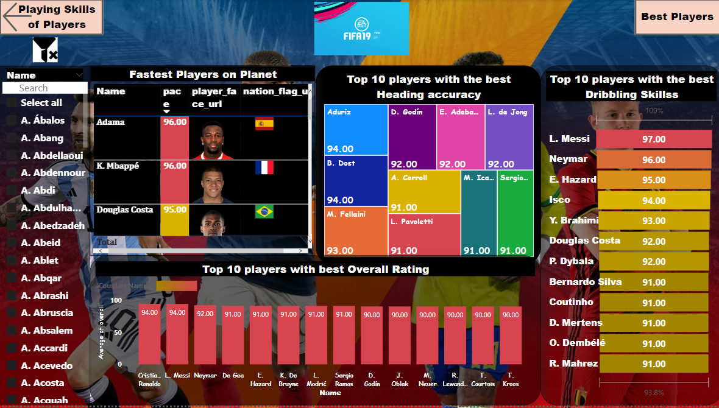
Aduriz and B.Dost has the best heading accuracy that is 94 percent.
England is the best team when they are attacking.
Cristiano Ronaldo is the fittest player when it comes to talking about power,strength and stamina.
L.Messi is the best Dribbler and finisher.
Cristiano Ronaldo and L.Messi has the best Overall Score
Adama and K. Mbappe are the fastest players on the planet.

Slide 6
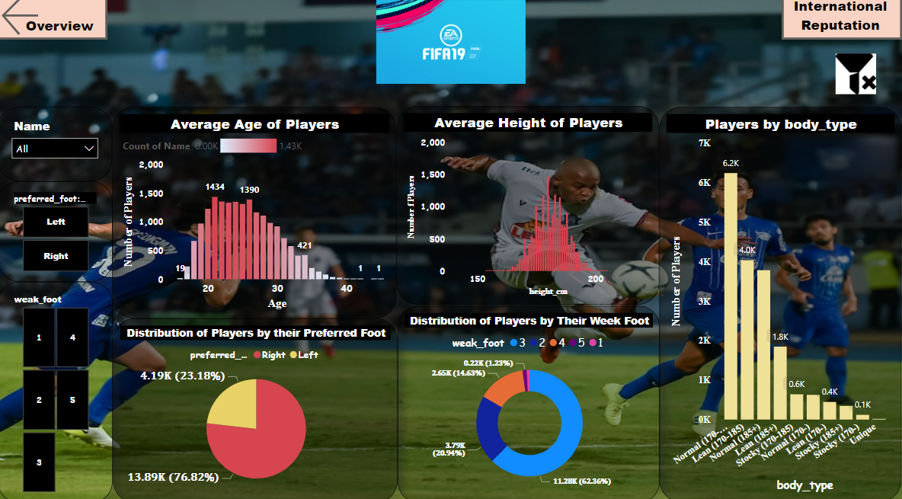
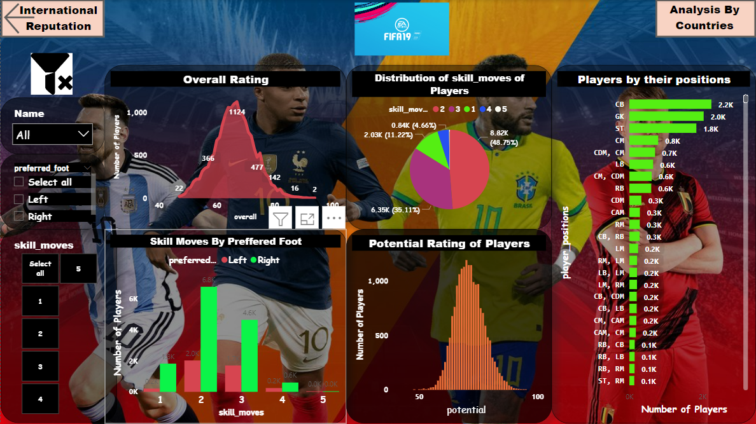
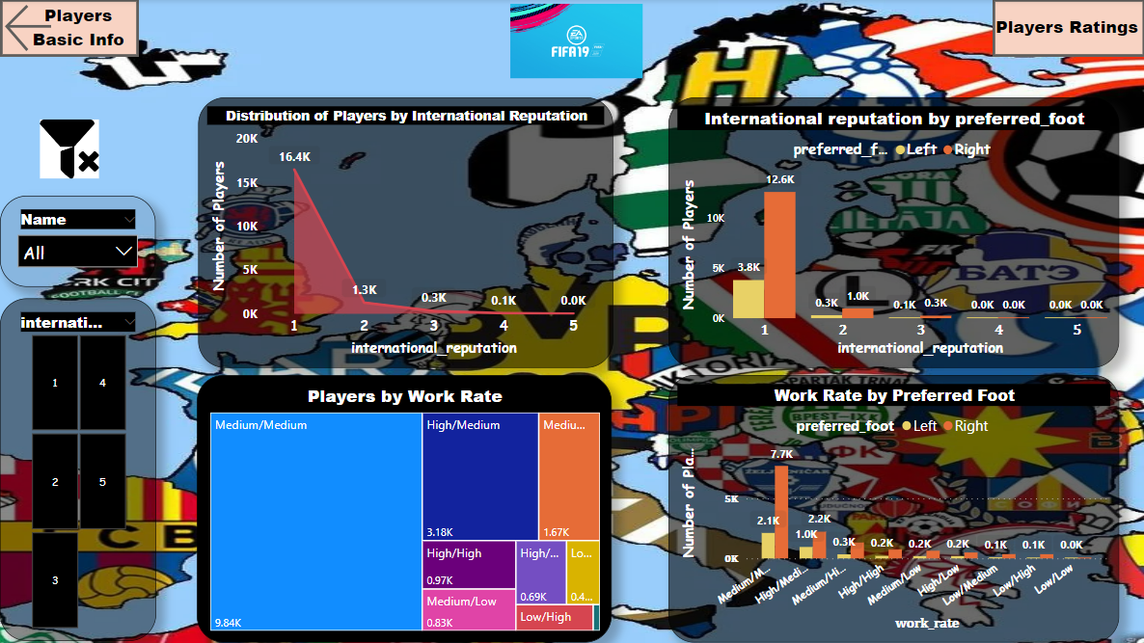
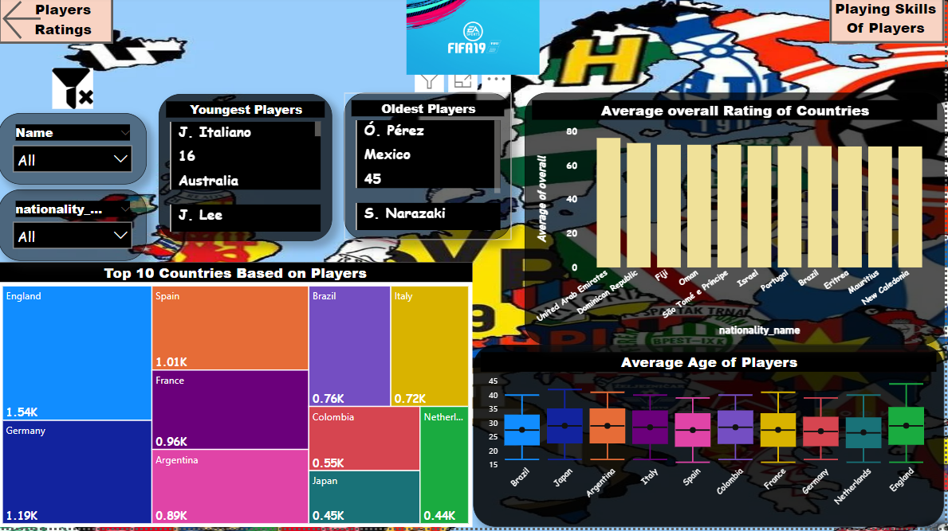

Slide 7
The average age of the Players participating are 21 years old and the average Height is 180 cm.
The age of the youngest player is 16 years.
Most of Players have the Normal Body Type (170-185). and 76.82% of players prefer to play with their right foot.
Players are divided into 5 scales (1-5) based on their reputation internationally depending on their performances. 16439 players have a international reputation of 1.
Left foot players are more internationally reputed then right foot players.
The average overall rating of the players are 67. Only 2 players C. Ronaldo and L. Messi has an overall rating of 94 which is the highest rating
England has highest number of Players participating in the tournaments.
England, Netherlands, France, Spain has the youngest palayers participating in the tournaments and the youngest players age are 16 years old.
Mexico, Japan has the oldest players.

Slide 8
THANK YOU

